Slide 1

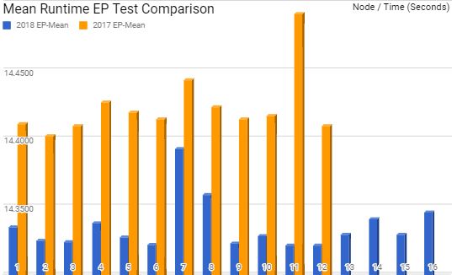
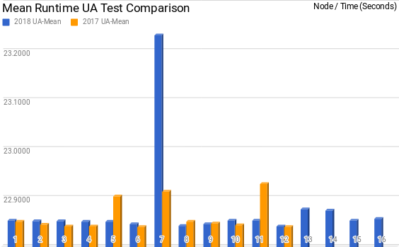
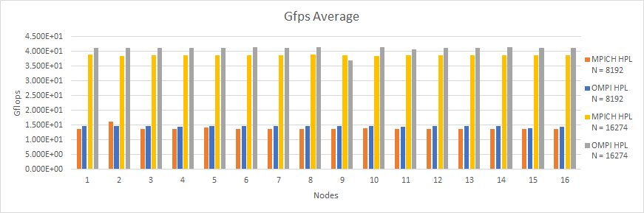


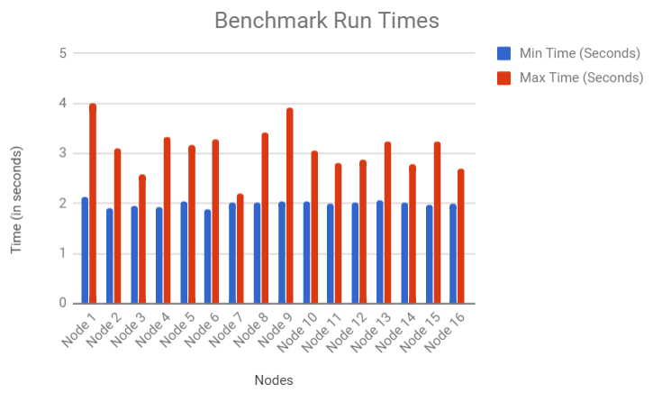


Performance Variation Of JMU Cluster
Bryan Secoy, Danielle Bowser, Thomas Shattuck, Obi Chukwuezi
What is the JMU Cluster and performance variation?
Single Node EP and UA Testing
The JMU Cluster is a group of 17 connected servers that can be thought of as a single entity. One node is dedicated to managing login tasks, while the other 16 are used for executing programs in parallel. Each node has a single central processing unit (CPU), each of which has 8 cores. This allows for a combined total of 128 processes to be utilized. Variation in this case is the performance differences of each CPU of the cluster. Our goal is to identify performance differences between the nodes and come up with a hypothesis of why identical hardware varies in performance.
High Performance Linpack Tests and Results
WHAT IS HPL?
High Performance Linpack (HPL) is a software package that solves a (random) dense linear system in double precision (64-bit) arithmetic on distributed-memory computers. It can thus be regarded as a portable and freely available implementation of the High Performance Computing Linpack Benchmark.
This work is a continuation of the cluster performance analysis performed by a group from the 2017 school year. Originally they ran two tests on the cluster. These tests were the embarrassingly parallel (EP) test which was meant to run serially and the second, UA, was meant to test parallelization by computing a complex equation in parallel. These were run on the then 12 node cluster across all 96 cores. Each test was performed in 20 trials per core to help derive conclusive data. They performed statistical analysis on the results of each core and node which included information on mean runtime (in seconds) and standard deviation. Our group maintained this format to test the four new nodes with the EP and UA tests, giving the cluster a total of 16 nodes and 128 cores.
The tests were then re-ran on every node simultaneously to test variation of the data a year later. The results from re-running the EP test with the original 12 nodes showed faster performance than previously recorded however the results of the UA tests were relatively the same. They concluded that node 12 performed the best in both tests and node 11 was the worst. Our results show that node 12 still performs very well but additionally node 2, 3, 6, and 9 performed in almost the same fashion. Node 7 performed the worst for both of these tests and node 11 had average performance. We know that the variation in these results is not from any other computation on the nodes as we used the entire cluster while they executed. Since node 7 is not used as often as the lower level nodes it is not likely that bad performance is from wear and tear.
We tested all 16 nodes on the cluster individually using HPL tests compiled with MPICH and OMPI, as well as two different input values. Each HPL test consists of 4 tests that create 1x8 or 2x4 tables, and test them against a block size of 96 or 256. The test results give the speed of the CPU in Floating Point Operations Per Second (FLOPS).
Meet The Team
HPL Findings
The results of the tests show that when HPL is compiled with OMPI, it runs faster than when it is compiled with MPICH for both input sizes. The HPL tests with larger input sizes run much faster than the tests using a smaller number of inputs. This leads us to believe that there is a direct correlation between the input size and the efficiency of HPL. With OMPI compiled HPL tests, we see a speedup of 181% when going from an input size of 8,192 to 16,274. HPL compiled with MPICH has a speedup of 178% with the previous input sizes. This shows that the input size makes a much larger difference in performance that the compiler used for the HPL tests. There is not enough conclusive data to identify a fastest or slowest node in the cluster based on our results.
Custom Multi-Node Benchmark Test
This test assessed internode communication by putting the nodes through combinations of collective MPI functions transferring large amounts of data, using each node respectively as a root. The tests that the data reflects are Scatter-Gather and Broadcast-Reduce tests. This data lists the minimum and maximum runtimes out of the 20 tests run on each of the 16 nodes in seconds. Node 1 has the biggest difference in times, while node 7 was the most consistent. The maximum tended to greatly fluctuate, with node 7 running collective operations the quickest, and nodes 1 and 9 having the highest runtimes. This would seem that node 7 has the most stable internode behavior, although we do not have fully conclusive evidence to prove this conclusion. Further testing needs to be performed to verify that these findings are consistent.
Danielle Bowser
Obi Chukwuezi
Future Work
Some opportunities for future work on this project could include:
Flesh out internode testing by doing more in-depth variance analysis
Increase the HPL input values
Compare the performance of the JMU cluster to other clusters
In addition to EP and UA benchmarks, research and attempt to run more NAS Parallel Benchmarks
Bryan Secoy
Thomas Shattuck

